Slide 1
Lecture 08 – Sequential circuits and key computer building blocks
2017.09.08
What I try to do … is to trace the chain of relationships running from elementary particles, fundamental building blocks of matter everywhere in the universe, … all the way to complex entities, and in particular complex adaptive system like jaguars.
Murray Gell-Mann, physicist

Slide 2
Announcements
If you wish a DRC environment for midterm
Provide me your Letter of Accommodation by Wednesday, Sep. 13
Request DRC evening time for Sep. 21
In consideration of the CS Career Fair there will be no clicker quiz on Monday, Sep. 11

Slide 3
Announcements
Readily-preventable late assignment submission leniency ends Monday, Sep. 11
Avoid preventable late submission “sad stories”
I uploaded Word on time, forgot “PDF!” until too late
I just totally forgot about the deadline
I started my upload early, at 11:57:50 p.m.,
but it didn’t finish until after 11:58:00 p.m.
because my roommate was binge-watching 8K video
Help yourself live happy; upload with care, early
The sad story you prevent will be your own

Slide 4
Combinatorial and Sequential circuits
Combinatorial circuits implement Boolean functions that are defined by truth tables
Output = f(inputs); Inputs alone determine outputs
No ability to retain a history of previous inputs
Sequential circuits implement finite state machines (computers) and are defined by next state diagrams
Memory of all past sequential circuit inputs is represented by the current state, implemented as bits stored in a register
Next state = f(current state, current inputs) where f( ) is a combinatorial function and circuit

Slide 5
Sequential circuit viewed in time
Circuit transitions from one state to the next state, and so on
Register (collection of 1-bit memories) to hold current state
Combinatorial circuit to compute
next_state = f(current state, inputs)
State i
State i+1
State i+2
f()
f()
• • •
INPUTS
at time i
INPUTS
at time i+1
Time

Slide 6
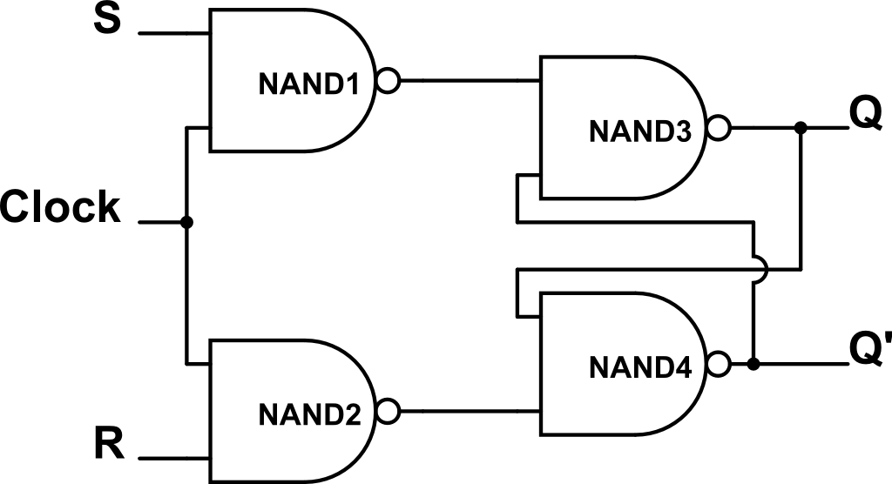
Improved register component: RS Flip-Flop
RS flip-flop is S’R’ latch controlled by a clock
If Clock=1, then S and R inverted and sent to latch
If Clock=0, then latch sees S’=1 and R’=1
Characteristic table
S | R | Q(t+1) | Comment
0 | 0 | Q(t) | No change
0 | 1 | 0 | Reset
1 | 0 | 1 | Set
1 | 1 | ? | Not allowed

Slide 7
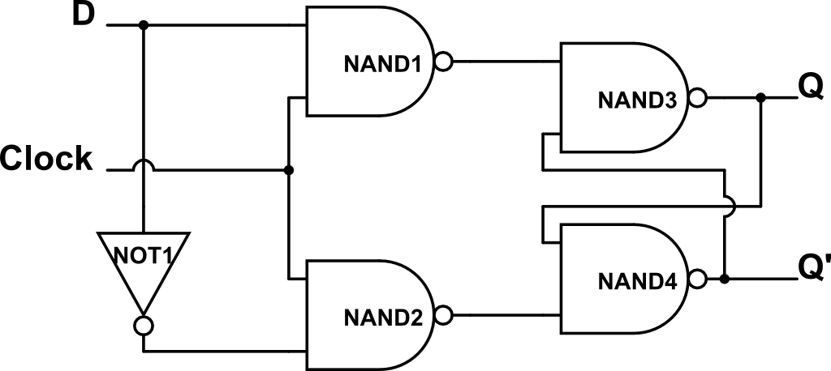
D (data) Flip-Flop: simpler to use than RS F-F
D (data) flip-flop is an RS F-F with R = S’
Characteristic table, whenever clock is high
D | Q(t+1) | Comment
0 | 0 | Reset, or clear
1 | 1 | Set

Slide 8
Making F-F easier to use in time
So far, flip-flops are sensitive to their input whenever the Clock is at the high logic level
Want to have more precise control of when flip-flop will sense its input
Prevent F-F from watching the changeable output of a continuously computing combinatorial circuit

Slide 9
Digital logic signal voltage waveform
Look for a precise marker of time
Time advances →
10⁻⁹seconds per tic mark, for example
High band
Low band
1) Low level
1) Low level 2) High level
1) Low level 2) High level
3) Rising edge 4) Falling edge
1) Low level 2) High level
3) Rising edge
1) Low level 2) High level
3) Rising edge 4) Falling edge

Slide 10
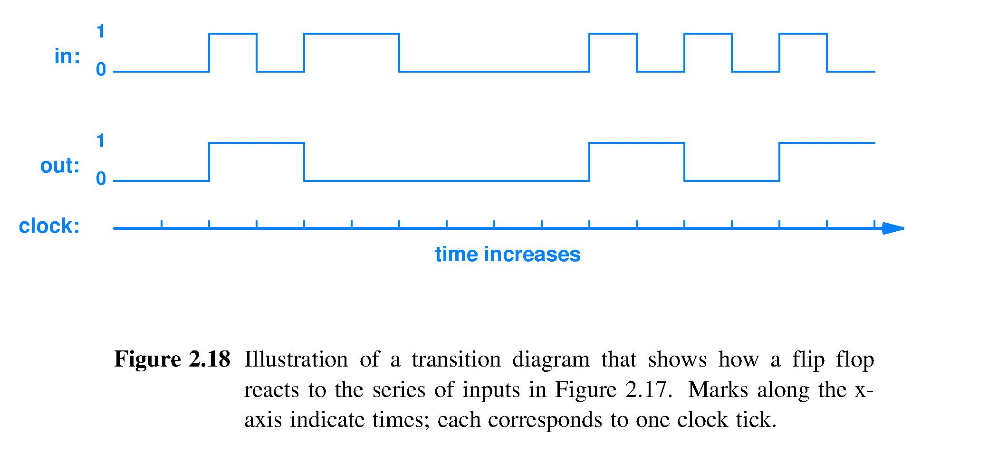
Digital waveform
Rising and falling edges are often drawn in diagrams as if ideally digital, i.e., drawn as vertical lines
See our textbook Figure 2.18

Slide 11
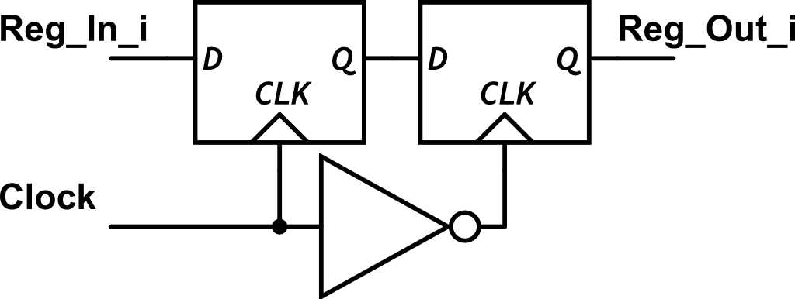
Flip-flop design using clock edges
Reg_In_i input ignored
Falling edge loads 2nd D flip-flop from 1st
Clock waveform
Rising edge loads first D flip-flop with Reg_In_i
Reg_In_i again ignored

Slide 12
Edge-triggered, n-bit register
A_{n-1}
A_{n-2}
A₂
A₁
S
R
A₀
Input
Edge-triggered Clock
1-bit
F-F
1-bit
F-F
1-bit
F-F
1-bit
F-F
1-bit
F-F
1-bit
latch
Q_{n-1}
Q_{n-2}
Q₂
Q₁
Q₀
Output
V-shape on clock input means edge-triggered Falling clock edge is when newly-stored A bit appears on Q output

Slide 13
Putting together the sequential circuit
INPUTS
f( )
Combinatorial logic
State register
Current state 2
Current state 1
Next sate
Output
__↑ Clock
Clock ___
Clock ↓____
Clock rising edge ↑ admits Next State bits into State register Clock falling edge ↓ reveals these bits on State register outputs, where these bits are now called the Current State
Falling edge ↓ is a starting gun for the Combinatorial logic, which instantly starts to perform its designed function

Slide 14
The sequential circuit - abstractly
INPUTS
f( )
Combinatorial logic
State register
Current state
Next state
Output
Clock
This abstraction represents any computer

Slide 15
Sequential circuit & program execution
Conventional programming languages are intended to be executed line-by-line in sequence
Sequential circuit, with its current-state, next-state operation, makes a good match with such programs

Slide 16
Pointing – a fundamental program action
All of these actions are synonyms
Name one of N choices
Select one of N choices
Point to one of N choices
Address one of N choices
Programs name, select, point, or addresses frequently
Need a circuit to {name, select, point, address}

Slide 17
Pointing, visually
Interpret and address, select, name, or point to chosen item
Name
Selection
Address
Pointer

Slide 18
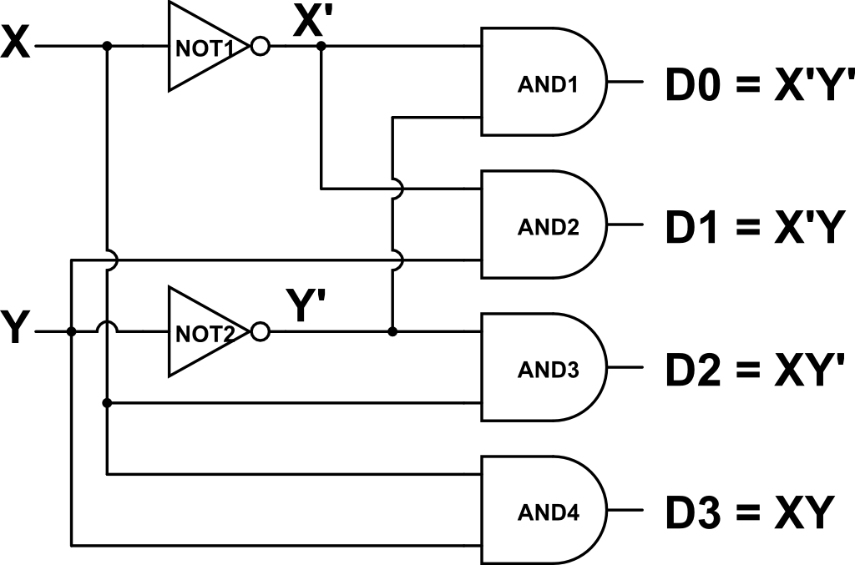
Circuit for pointing – the decoder
Example: 2-bit number (input) with bits XY and 2² =4 locations to point to: D0, D1, D2, D3
Truth table and circuit; 2 inputs, 2² outputs
X | Y | D0 | D1 | D2 | D3
0 | 0 | 1 | 0 | 0 | 0
0 | 1 | 0 | 1 | 0 | 0
1 | 0 | 0 | 0 | 1 | 0
1 | 1 | 0 | 0 | 0 | 1

Slide 19
Pointing, larger example – 3x8 Decoder
A2 | A1 | A0 | Y7 | Y6 | Y5 | Y4 | Y3 | Y2 | Y1 | Y0
0 | 0 | 0 | 0 | 0 | 0 | 0 | 0 | 0 | 0 | 1
0 | 0 | 1 | 0 | 0 | 0 | 0 | 0 | 0 | 1 | 0
0 | 1 | 0 | 0 | 0 | 0 | 0 | 0 | 1 | 0 | 0
0 | 1 | 1 | 0 | 0 | 0 | 0 | 1 | 0 | 0 | 0
1 | 0 | 0 | 0 | 0 | 0 | 1 | 0 | 0 | 0 | 0
1 | 0 | 1 | 0 | 0 | 1 | 0 | 0 | 0 | 0 | 0
1 | 1 | 0 | 0 | 1 | 0 | 0 | 0 | 0 | 0 | 0
1 | 1 | 1 | 1 | 0 | 0 | 0 | 0 | 0 | 0 | 0
Three address bits A₂A₁A₀ name 2³ = 8 locations (8 rows)
Eight outputs, Y₇Y₆ … Y₁Y₀, each point to 1 distinct location
Notes:
Easy SOP circuit

Slide 20
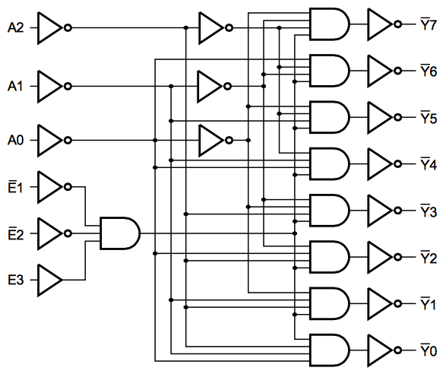
Lab kit 74HC138 3-to-8 decoder circuit
Decoders take in an address, output a selection, a pointer
8 SOP terms
Power to drive many gate inputs
Signals used if wish to link two or four 74138s into larger 4-to-16 or a 5-to-32 decoder

Slide 21
Multiplexer/demultiplexer for memory access
Bus – collection of N wires used to carry N bits of data simultaneously from place to place
Circuit to select 1 from 2^{k} data buses
Multiplexer (Mux): select 1 of 2^{k} input buses and forward selected input to the 1 output bus
Demultiplexer (Demux): forward the 1 input bus to the selected 1 of 2^{k} output buses
Mux used to read from the pointed to memory location
Demux used to write to the pointed to memory location

Slide 22
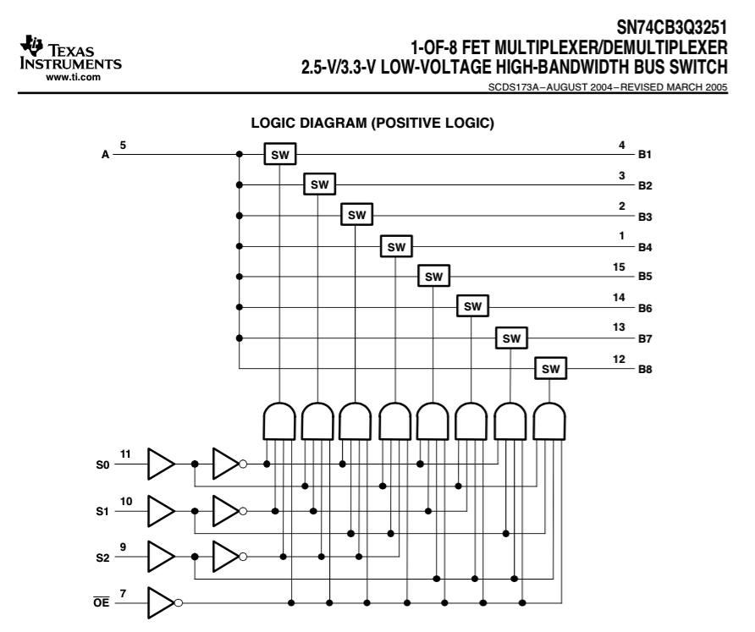
74251: 1-of-8 mux/demux circuit
A is Demux input, Mux output
B1 to B8 are Demux outputs, but Mux inputs
Data path
8 SOP terms
3 pairs of input drivers
Control path
Enable’

Slide 23
1 of 2^{n} multiplexer, more abstractly
Input lines; selected from; one is sent to output
0
1
…
2^{n-1}
Selection Address Pointer
0
1
Mux
…
n
No circuit now; just a box labeled Mux
Output

Slide 24
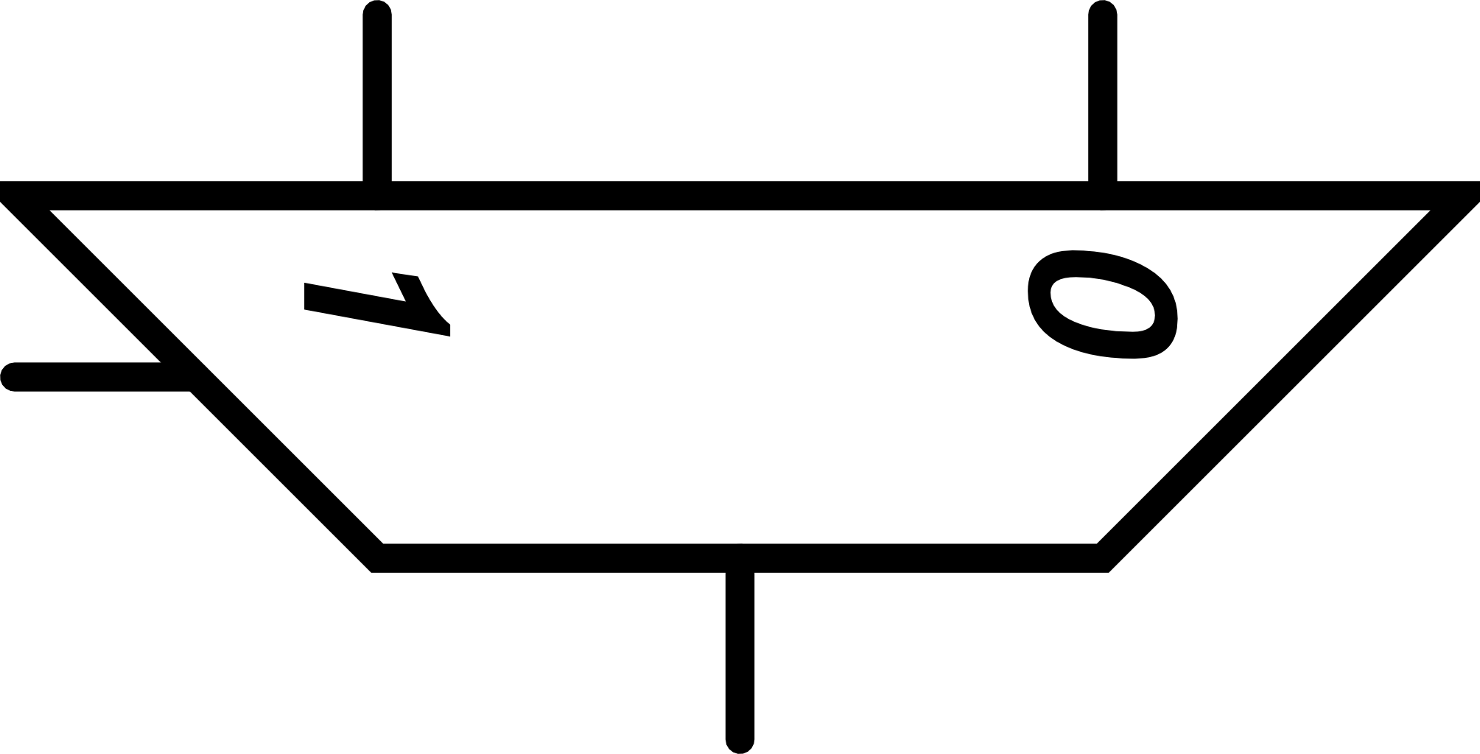
Multiplexer also used to choose
Select one of several outcomes
Like a Java switch/case statement
0
1
…
2^{n-1}
0
1
Mux
…
n
Even more abstract mux symbol used in textbook
Output

Slide 25
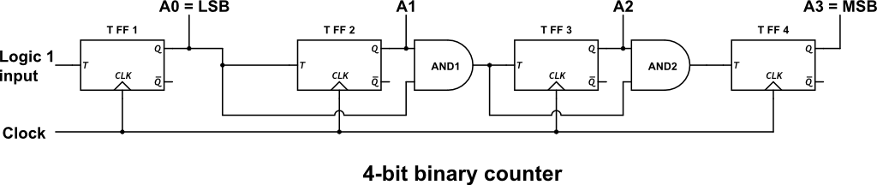
4-bit binary counter using T flip-flops
T flip-flop changes state if T=1, not if T=0
Circuit that counts modulo 2^{n}
Think of this circuit as the code written in hardware that implements the binary counting algorithm (à la CS251)

Slide 26
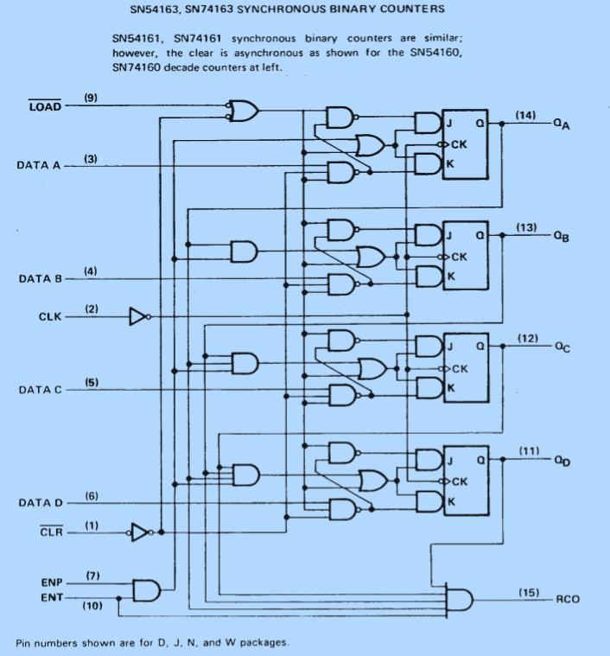
Binary counter in lab kit
More complex than previous circuit to include these capabilities
Can load a chosen 4-bit count value
Faster, because AND gates are not daisy-chained
RCO (carry-out) allows n-bit chaining of counters

Slide 27
Binary counter algorithm, with better initialization, I/O, and optimized performance
Core algorithm plus these user interface and performance capabilities:
Can load a chosen 4-bit count value
Faster, because AND gates are not daisy-chained
RCO (carry-out) allows n-bit chaining of counters

Slide 28
Summary
Combinatorial circuits implement truth tables
Sequential circuits implement finite state machines
Fundamental sequential circuit is the latch and its more usable cousins, the flip-flops
Key basic computer building blocks include: register, decoder, mux/demux, counter
Hardware can be viewed as the lowest level code in a hierarchy of abstraction

